Slide 1
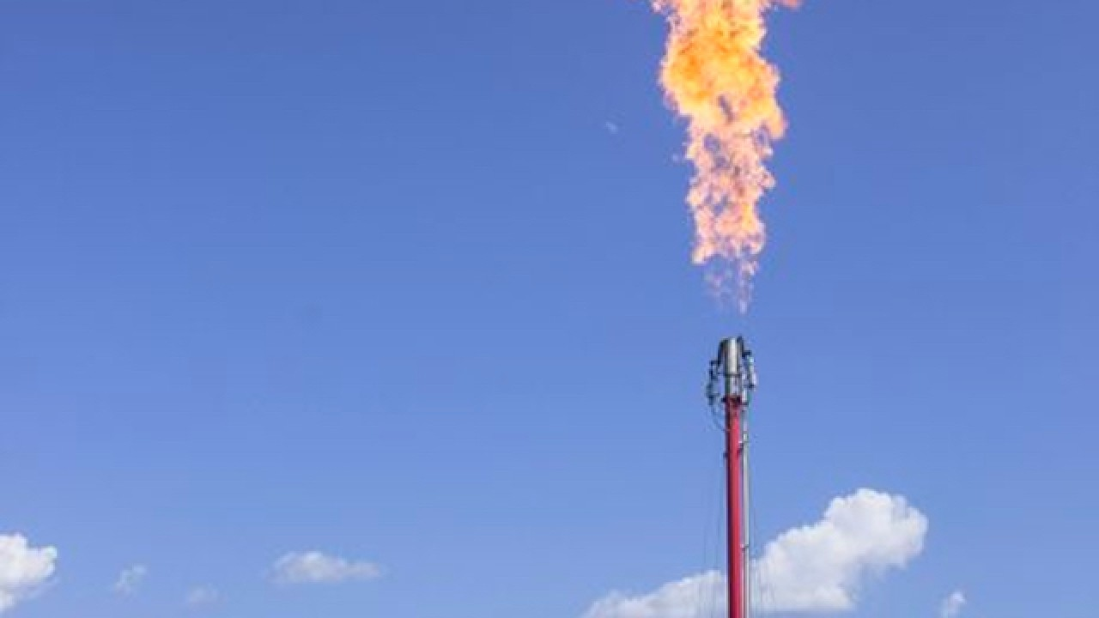
Wasted Energy:
An analysis of energy wasted to flaring
By Chad Hutchison

Slide 2
The Why
Energy drives the global economy – wasting it is bad
Most oil/gas producing states report flaring data
Solving problems begins with quantifying them

Slide 3
The Goals
Evaluate the scale of energy waste
Test the difference between waste in Texas vs. US
Provide context on the issue to quantify the waste
Provide the foundation for future examination

Slide 4
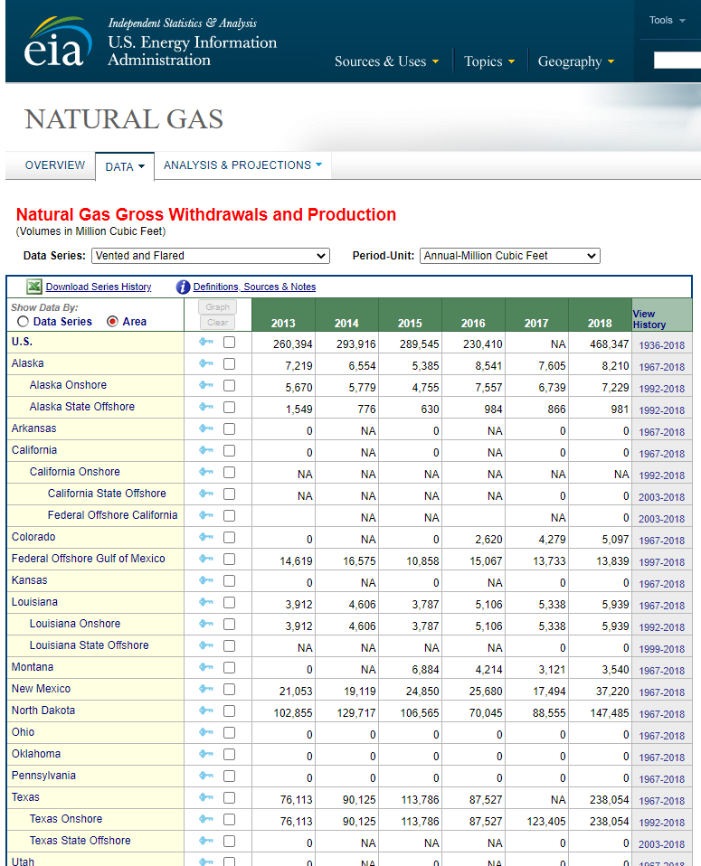
The Data
BY STATE Flared:
https://www.eia.gov/dnav/ng/ng_prod_sum_a_EPG0_VGV_mmcf_a.htm
BY STATE CRUDE OIL Production:
https://www.eia.gov/dnav/pet/pet_crd_crpdn_adc_mbbl_m.htm
BY STATE Natural Gas production:
https://www.eia.gov/dnav/ng/ng_prod_sum_a_EPG0_FGW_mmcf_a.htm

Slide 5
The Test
Texas is the #1 oil/gas producer in the country
Compare the ratio of flared energy to energy produced for Texas and US
Null Hypothesis: The mean energy waste ratio between Texas and the US is the same
Alternate Hypothesis: The mean energy waste ratio between Texas and the US is different
Method: Welch’s t-test between US and Texas
Alpha: 0.05

Slide 6









The Tech

Slide 7
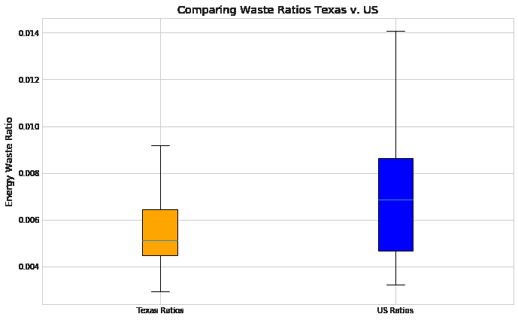

The Results
Waste ratio:
$\frac{kWh wasted (flared)}{kWh produced (from oil + gas)}$

Slide 8
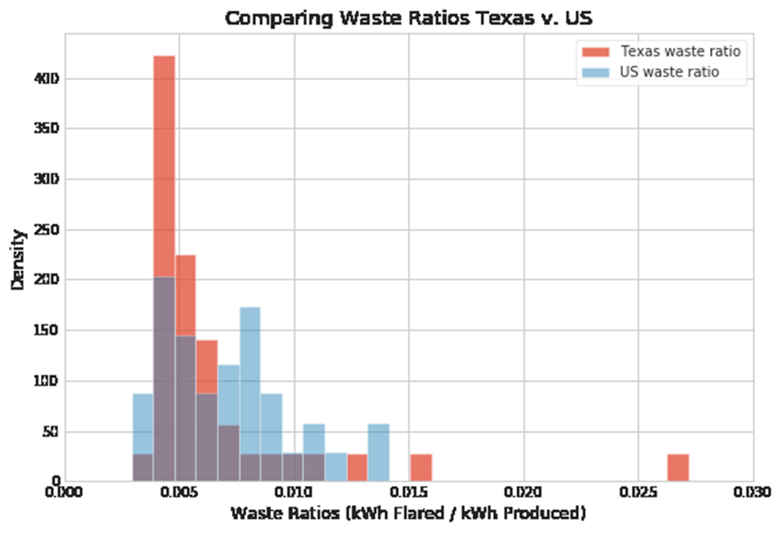
The Results
Welch’s t-test results:
P-value: 0.23
α: 0.05
FAIL to reject the null Hypothesis

Slide 9
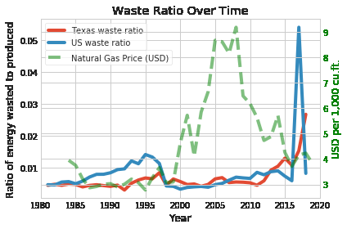
The Perspective
The cost to bring to market drives the need to flare

Slide 10
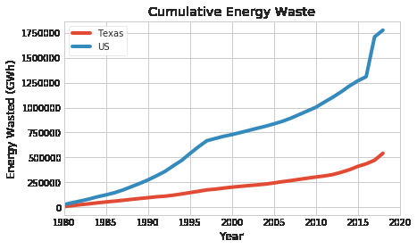
The Perspective
What could have been:
Total energy wasted since 1980:
Powered 161 million homes for a year
Total energy wasted in 2018 alone:
Send a Tesla to the sun and back 3,028 times*

Slide 11
The Next Steps
Compare waste of all states to US / Texas
Dig into data from states known to flare but not reporting
Add location data to flare sites in US
Compare with map of network connectivity
Use the energy for…?
Go global

Slide 12

The End
Email:
chad.b.Hutchison@gmail.com
Github:
www.github.com/chad-hub
LinkedIn:
https://www.linkedin.com/in/chad-hutchison-b1670657/

